Slide 1
Workbook Cash Flow (Historical)
Internal Use Only
April 2017
EXCEL FILE:

Slide 2
Disclaimer
The content of this workbook has been produced by KPMG Germany/Deal Advisory on the basis of German accounting standards and/or IFRS, as well as considering KPMG Germany’s firm and country requirements, regulations, processes, policies and best practices. Please check your local accounting and other requirements before applying the content.

Slide 3
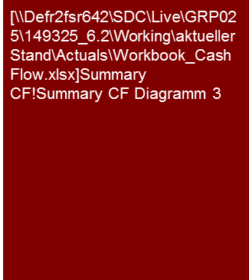
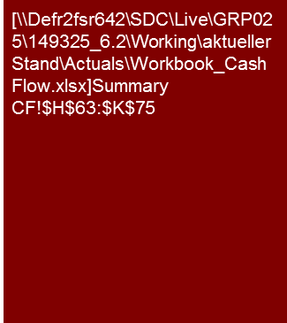
Overview
Cash Flow (historical)
Flag: The presentation of operating cash flow deviates from accounting standards. This workbook contains sample financial statements according to IFRS and German GAAP
Mission Statement:
Cash flow is key for any valuation and for restructuring purposes. It combines the insights from P&L and balance sheet analysis.
Customer situation
Definition/Methodology/Tools of the basis analysis
Buy Side/Sell Side/JV
Cash flow is a material parameter of the valuation and therefore for determining the purchase price.
Cash Conversion (EBITDA to operating cash flow) offers important insights into the attractiveness of the business model
Turnaround
Poor cash conversion or negative free cash flows are a warning of threatening liquidity problems.
Free cash flow is a decisive criterion for maximum indebtedness.
Cash conversion
Definition and Methodology
Definition:
Operative cash flow analysis should be aligned to the P&L analysis, i.e. before interest and taxes when comparing to EBITDA
Cash conversion: Operating CF / EBITDA;
Free cash flow is not defined uniformly, in the simplest case approximated as operative cash flow minus capex (for valuation models => see page 5);
Cash flow from financing activities shows the change in the financial debt and capital measures ("debt-like items" are generally considered in the operative cash flow);
Normalizing cash flows is tricky. Many EBITDA adjustments are non-cash (change in valuation) or out-of period (provisions) and do not show up in the cash flow for the same period. Material 'exceptional cash flows' (e.g. cartel fine) might be presented after the free cash flow as such; but we should not present a "pro-forma" cash balance excluding exceptional in- or outflows.
Methodical use of the cash flow analysis:
A cash conversion analysis at the front of a report can be helpful to visualize material cash flow findings, non-cash one-offs in reported earnings; and going concern risks from insufficient cash conversion.
A full cash flow presentation is the basis for every DCF valuation and for an integrated planning model. Reconciling to P&L and balance sheet ensures we have a firm grip on the numbers (but should be presented in an appendix only).
Degree of Standardization
Presentation of operative cash flow for cash conversion before interest and taxes (deviates from accounting standards).
Excel template for cash flow presentation (Exception: If the target has a cash flow reporting we should seek to adopt that rather than forcing our cash flow format upon management).
Note: *) bef. interest, tax and exceptional items.

Slide 4
Pitfalls and lessons learned
Cash Flow (historical)
No. | Specific analysis
 | Risk from poor cash conversion not properly considered/presented War story: Buy-side FDD on a target in construction industry. Profitable with almost 7% EBIT margin. Significant WC build up over 3 years due to poor payment morale of public sector debtors. Additional WIP in current trading period could no longer be financed, resulting in insolvency. While the issue of the increasing working capital requirements was prominently presented in the reports, the risk of insolvency was not flagged as such. Remedy: Presentation of the "cash conversion" in a prominent place, supplemented by debt to EBITDA (financial gearing) ratio analysis.
 | Descriptive cash flow comments with limited value-add Problem: Cash flow analysis is presented after the P&L and the balance sheet, and cash flow comments only repeat EBITDA, working capital and capex discussion from preceding report sections (or worse: the comments merely explain how the cash flow was compiled). Remedy: Show cash conversion at the beginning of the report, with core statement on EBITDA, working capital and capex effects (ideally with reference to the corresponding parts of the report). Cash flow details only uncommented in the appendix.
 | Lack of reconciliation on change of level of funds for payments and other balance sheet changes In cases of poor data and/or time pressure frequently only "indicative operative cash flows" are presented, sometimes as simplified as EBITDA minus change in working capital and without reconciliation to balance sheet movements. This increases the risk that important cash flow effects may not be considered properly (e.g. gains from sale and leaseback, factoring of working capital). Furthermore, such simplified ('illustrative') cash flow analysis will almost inevitably receive less attention than P&L and balance sheet analysis, and important cash flow findings (e.g. poor cash conversion, excessive financial gearing) may not get the appropriate attention. We should thus seek to obtain or prepare ourselves a cash flow that reconciles with P&L and balance sheet movements, ideally with respective workings presented in the appendix. If in doubt clarity is more important than meticulous accuracy, i.e. to keep cash flow workings simple and understandable minor non-cash gains from the disposal of assets may not need to be reclassified from operating to investing cash flow. If necessary, document assumptions made or simplifications applied.
 | Confusing caused by cash flow normalization Problem: If we attempt to present a 'fully normalized cash flow' (analogous to underlying EBITDA) we would end up with a presentation of pro forma cash (not a very credible term) and often complex supporting calculations which can hardly be presented in an understandable manner. Remedy: As a general rule, refrain from 'normalizing' cash flows level, but for individually material 'exceptional items' which shall be presented as 'cash flow related to exceptional items' below free cash flow (e.g. cash outflow from restructuring, with respective adjustments to movements in provisions as applicable).
1
2
3
4

Slide 5
Core issues
Cash Flow (historical)
Flag: Please check your local accounting and other requirements before applying the content.
Core Issue | Specific analysis | Page(s)
(How) does P&L profitability convert into operative cash flows? | Possible reasons for differences: Business model related factors (e.g. increasing working capital requirements due to foreign expansion) Accounting effects (e.g. changes in valuation or accounting methods) Timing effects (e.g. creditor payments shortly before or after the balance-sheet date) Analysis of cash conversion rate (EBITDA to operating cash). Trend Analysis of cash conversion over time and reason for changes therein. Potentially benchmarking cash flow in % of sales versus peers. | 10
How high is capex and can it be financed by operative cash flow? | Free cash flow analysis (EBIT to free cash flow conversion). Consider insights gained from the P&L and balance sheet analysis (e.g. leasing vs. purchase; sale and leaseback activities; development costs and own work capitalized; IAS 16 accounting for major maintenance, etc.) see also workbook Fixed Assets - CAPEX | 11/12
What impacts result from the free cash flow analysis for the financing? Is the FCF sufficient to service current interest and debt? Are there signs of financial tensions? | Historical analysis to show whether free cash flow was sufficient to cover debt service (interest and repayments) Negative free cash flows should trigger further analysis into their cause (major investments/acquisitions or poor operating cash flow generation?) and into remaining headroom for futures debt / existing covenants | 11/12
(How) will the historical Cash Flow profile develop in future? | This ”key question" requires an interpretation of the results from the previous three questions. Analytic thought and experience are especially required here. See also Cash Flow (Planning) workbook. | 11/12
360° CQ

Slide 6
Direct versus indirect method
Cash Flow (historical)
Flag: The presentation of cash flow deviates from accounting standards. This workbook contains sample financial statements according to IFRS and German GAAP
Indirect method
Direct method
Indirect cash flow derivation
(common used form in Deal Advisory)
Direct cash flow derivation
(primarily used for short-term liquidity calculations in Deal Advisory (e.g. Restructuring))
P&L
Balance sheet
Deposits
Payments
Cash flow
Cash flow
Reconciliation to P&L and balance sheet increases perceived comfort in the numbers.
Part of the financial statements according to IFRS, according to HGB (German Commercial Code §297) only mandatory for consolidated financial statements.
Frequently not part of a monthly management reporting (and if, then not verbally commented on), but rather generally compiled retrospectively (i.e. on annual basis).
In many companies' business planning procedures, the cash-flow plan is only an output produced based on P&L and balance sheet plans. However, it is key to ensure the consistency of any (integrated) P&L and balance sheet planning model.
Generally used for liquidity planning with a short-term horizon of up to 3 (max.12) months, frequently weekly rolling.
Typically "system-generated", so that direct cash flows can often not be compiled without access to the company.
Reconciliation to P&L and balance sheet hardly possible.

Slide 7
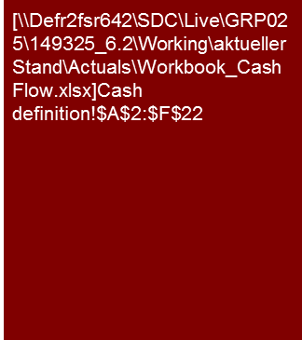
Definition of cash
Cash Flow (historical)
Flag: Cash definition for cash flow purposes deviates from accounting standards. The cash definition on this page relates to IFRS.
Accounting versus commercial definition
Accounting standards generally prefer a narrow definition for 'cash funds', limited to cash and cash equivalents only (IAS 7.6) monetary asset items of the balance sheet, with total term of a maximum of three months).
However, IFRS acknowledge that in ‘some countries, bank overdrafts … form an integral part of an entities’ cash management’ (IAS 7.8) and permits including them in the definition of cash and cash equivalents for cash flow reporting purposes (see IAS 7.45ff respective disclosure requirements).
Impact on cash flow
Depending on the definition of 'cash funds' movements in bank overdraft, the cash flow will present movements therein either as financing cash flow (narrow definition of cash funds) or as part of changes in cash (commercial definition)
Interest expense/income and Income tax
IAS 7.33 leaves the option to classify interest received and paid either:
both within operating cash flow; or
interest paid within financing and interest received within investing cash flows.
Per IAS 7.35 tax payments shall generally be presented as operative cash flow unless they can clearly be allocated to financing or investing activities (and Restructuring opinions follow this approach).
KPMG’s “Guide to annual financial statements - Illustrative disclosures” suggests to present a subtotal “Cash generated from operating activities” before interest and tax, and to then deduct Interest and Taxes paid to arrive at “Net cash from operating activities”.
In Deal Advisory:
EBITDA to operating cash conversion analysis should focus on the above “Cash generated from operating activities” (to compare apples to apples);
net interest payments should be presented within cash flow from financing activities, unless there is specific reason not to; and
tax payments shall be presented as a separate line before arriving at Free Cash Flow
Definition of cash in restructuring situations (opinion)
With a restructuring concept the banks look at the net liquidity and the available liquidity or liquidity requirements.
This means the cash flow analysis also has to focus on these items, and hence short-term bank liabilities (overdraft) as well as short-term fixed deposits or fixed-rate loans must not be included in the 'cash funds' definition for cash flow purposes.
➔ "Cash Management” workbook

Slide 8
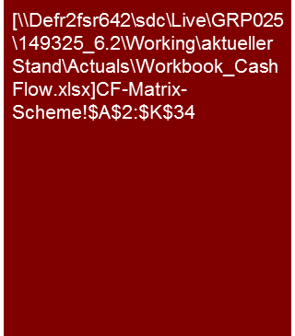
Sample format (indirect method)
Cash Flow (historical)
Equity changes impact primarily on the P&L:
EBITDA (operating cash flow)
Depreciation (non-cash)
Interest (financing cash flow)
Tax (separate line before arriving at Free Cash Flow)
Furthermore, dividends, capital increases, foreign currency translation reserves in the group, or other comprehensive income ("OCI" – non-cash) may need to be considered
(Gain)/loss from disposal of fixed assets (reclassification of oper. / invest. CF)
RES: Tax paid generally within operating CF.
Depreciation (non-cash, only required to reconcile with movements in fixed assets)
Disposal at net book value
(in case of any acquisitions or divestments, handle respective balance sheet movements in this line, e.g.:
-330 Working capital (trade + extended)
+140 Net debt (without cash acquired!)
- 370 Fixed assets
-400 Goodwill
= 960 Acquisition net of cash acquired
[Purchase price 1,000 less 40 cash acquired]
For divestments gains/losses must be considered (same as for disposals of fixed assets)
Restructuring cash flows are typical cases for applying exceptional items: Simplified example here shows utilization of provisions for restructuring
215 profit -20 dividends paid = 195 change in equity
General explanation:
This cash flow matrix format requires an extra effort to set up, but assures that all the balance sheet changes including the P&L result will be captured. This ensures consistency of the numbers (the cash flow will add up and if not, the error can be quickly be found), and can be used to present cash flow workings in a transparent manner.

Slide 9

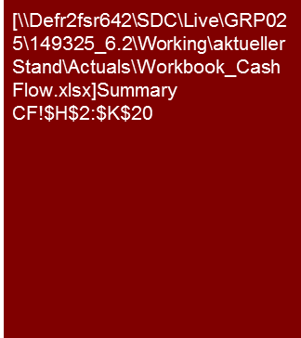
Example Analysis 1 – Cash conversion and operating cash flow
Flag: In Germany expert opinions such as company valuation according to standard IDW S1 and restructuring in accordance to IDW S6 require a conclusive opinion on cash conversion without open questions
Cash Flow (historical)
Historic cash conversion was poor, caused by increasing working capital.
When cash conversion will return to healthier levels is difficult to tell because:
It is a project business (→ lumpy cash flows);
without formal working capital management; which
shifted sales towards larger stationary installations.
We see a risk that cash conversion will remain an issue (and per our net debt analysis credit lines to cover working capital peaks may be difficult to obtain).
Cash conversion
Cash Conversion and operating cash flow
While EBITDA remained fairly stable, operating cash flows decreased significantly from 2010 to 2012.
In response to adverse market conditions in the ABC segment Target has replaced smaller ABC projects by fewer large projects for stationary generators.
Whilst EBITDA profitability was maintained, operating cash flows turned negative due to working capital increases (refer working capital section of this report).
Target considers the working capital increase as inevitable volatility caused by the project nature of its business (timing of project related payments), and has no specific working capital reporting or management in place.
For us there is no clear answer whether and if so how quickly working capital will return to old (Dec 2009) levels, or can at least be stabilized at the December 2012 level. As long as no dedicated working capital management is implemented, we would rather be concerned that cash conversion will remain a problem (one factor is that a number of clients and targets in Germany find it increasingly difficult to negotiate advance payments since the 2008 financial crisis; the second factor is, that the stationary XYZ business reflects fewer but larger projects, which adds to the lumpiness of cash flows).
As a result the company could require additional financing, which based on our analysis of financial debt and available credit lines (refer net debt section) may be difficult to obtain
Source: Annual reports 2010-12; KPMG Analysis
Note: DD reports may present open questions without conclusive opinions ("subject to further DD") Expert opinions (e.g. IDW S1 or S6 in Germany) in contrast, require a conclusive opinion. See also Cash Management workbook for RES example.
€236k lower than the balance sheet working capital increase. Reason are two generators which were in own use but shall now be sold.
Hence their book value was transferred from fixed assets to inventories
Proceeds from selling the old site were re-invested to buy a new property as well as new additional technical equipment (see fixed assets section).
Note: Refer to Appendix XXX for supporting cash flow workings
Source: Annual reports 2010-12; KPMG Analysis

Slide 10
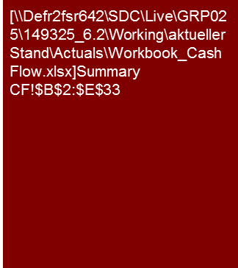
Example Analysis 1 – Cash flow summary
Cash Flow (historical)
After the discussion of P&L and balance sheet (including investments/capex) in preceding report sections, we often run out of insightful comments when presenting the cash flow, especially once we have discussed cash conversion at the front of the report.
In that case, consider to move the cash flow presentation into the appendix, perhaps with a few comments on specific items.
Proceeds from disposal reflect the sale of the old site in December 2011.
The respective gain on disposal of €3.2m is reported in extraordinary result, net of €124k extraordinary expenses related to legally wind down [four] no longer operating subsidiaries.
We present these proceeds within Investing Cash Flow because they were immediately re-invested to buy a new site in and new testing facilities for this new site.
Negative free cash flow in 2011 and 2012 was financed by:
€1.6 million reduction in cash in 2011; and
€2.6 million new loans plus a further €0.7 million reduction in cash in 2012

Slide 11
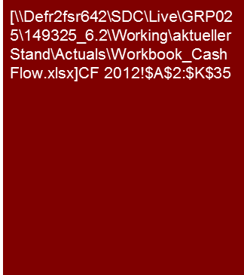
Example Analysis 1 – Cash flow workings 2012
Cash Flow (historical)
In this workbook we present cash flow workings for one year only.
A report should include such backup for each year (→ Excel Tool)
Reflects two generators which were in own use but shall now be sold.
Hence their book value was transferred from fixed assets to inventories.
Depreciation
Restructuring expense of €303k reported as "extraordinary expense" (below EBIT)
- less €94k movement in restructuring provisions
= €209k cash outflow in 2012
Note: “cash from exceptional items" corresponds conceptually with "extraordinary cash flows" in the RES format.
The RES format, however, presents extraordinary cash flows after the financing cash flow (”at the bottom”)
For typical RES format Cash flow presentation
→ Cash Management workbook.
Source: Annual report 2010-12; KPMG analysis

Slide 12
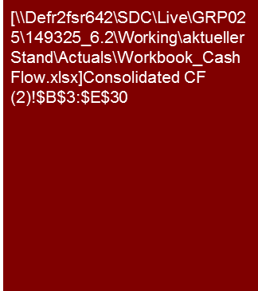
Example Analysis 2 – Supporting analysis CF (1/2)
Cash Flow (historical)
Example for Cash flow presentation based on Target’s Cash Flow Reporting [consider pros and cons of using ‘KPMG Standard’ instead]
Operating cash flow in the 1HX3 current trading appears more reflective of underlying levels than FYX1 and FYX2 , because prior years benefitted from effects, which do not appear sustainable (e.g. construction projects in inventory and tax refunds).
Historic (FYX1 and FYX2 ) capex was high due to construction of new plants, whereas current 1HX3 capex was significantly below depreciation.
As we understand management does not plan new plants we would expect capex levels for coming years to be comparable to depreciation levels.
Cash flow from operating activities
Changes in provisions were primarily related to the PPA related provisions at [...] and [...] as well as the following movements at [...]:
PPA adjustment in FYX1 (€13.6 million);
release of the [...] provision in FYX2 (€10.5 million);
[...] (maintenance and refinancing) (€15.1 million in FY11).
Change in working capital excludes movements in accruals and advance payments received which are included in other liabilities. The decline in working capital in FYX1 was driven by the construction project [...], which was completed in FYX1. Cash outflow from working capital in 1HX3 was mainly driven by a build-up in trade receivables. Refer to the working capital section of this report for further details.
Change in other receivables comprises operating receivables and receivables from tax authorities for current taxes. Changes in FYX2 are mainly related to [...] (€7.3 million) and to [...] (€39.9 million). The change in receivables of [...]is due to milestone billings and corresponding payments in connection with the construction project.
Changes in other liabilities are mainly related to [...] and are caused by a reduction of the accruals for [...]. Detailed analysis of accruals is set out within the working capital section.
Other cash inflow of €36.7 million in FYX2 is primarily related to down payments of [...] O&M fees.
If we receive a cash flow reporting from the company (target or client), we typically adopt that format for our analysis (unless it is grievously incorrect) rather than forcing our cash flow format upon management.
Otherwise management may be reluctant to discuss “their” numbers in our format, which they may not be familiar with.
Note: (a) Change in working capital refers to changes in inventories, trade receivables and trade payables
(b) Cash and cash equivalents at Jun-11 includes inter-affiliate receivables of €1.8 million
Source: […]

Slide 13
Example Analysis 2 – Supporting analysis CF (2/2)
Cash Flow (historical)
Financing cash flows include significant (re-) financing activities, including a capital contribution, but we did not identify a consistent pattern that could be extrapolated into future years.
Cash flow from investing activities
Cash flow from investing activities in FYX1 were significantly impacted by investments in fixed assets, mainly from construction projects [...], [...], [...] and [...]. Detailed analysis of capital expenditure is set out within the fixed asset section (note that the capital expenditures set out within the fixed asset section represent the additions to fixed assets without regard to the timing of actual payments, whereas the capital expenditures presented on the previous page consider the actual cash inflows and outflows).
Capital expenditure declined to €63.8 million in FYX2 with [...] accounting for more than half of total capital expenditure.
Income from disposal of fixed assets comprise income from the sale of the composting plant in [...] by [...]in FYX1 for €6.0 million and [...]’s disposal of its 75% share in [...] for €3.0 million.
FYX1 cash out for intercompany investments relate to investments into [...] (€24.6 million), [...] (€1.3 million) and [...] (€1.4 million).
Cash paid for financial receivables in FYX2 include capital expenditure in relation to [...] which was leased out under a finance lease arrangement in FYX2. Project related investment costs are capitalized as finance lease receivable and are thus not part of tangible fixed assets.
Cash flow from financing activities
Dividends paid to consolidated affiliated companies relate to payments made to the parent company [...].
Dividends paid to minority interests are mainly related to other shareholders of [...], [...]and [...].
Change in financial liabilities comprises additions and repayments under the Group financing facility.
Other cash inflow of €24.6 million in FYX1 relate to a capital contribution of [...] into [...]. FYX2 cash outflow of €37.5 million is mainly related to repayment of lease liabilities by [...] in relation to the [...] refinancing.
Before providing extensive description for individual cash flow elements ask yourself how much value that adds for your client. A few short but insightful bullet points in an Appendix may better address your clients needs.

Slide 14
Internal use only.
© 2016 KPMG International Cooperative (“KPMG International”), a Swiss entity. Member firms of the KPMG network of independent firms are affiliated with KPMG International. KPMG International provides no client services. No member firm has any authority to obligate or bind KPMG International or any other member firm vis-à-vis third parties, nor does KPMG International have any such authority to obligate or bind any member firm. All rights reserved.

